Slide 1
What’s an Object?
Data
( Attributes )
Functionality
( Methods )

Slide 2

In python, most of the things that we create are objects!!
class
object
attribute
method

Slide 3



< class str >
Functionality
(methods)
upper()
lower()
capitalize()
split()

Slide 4
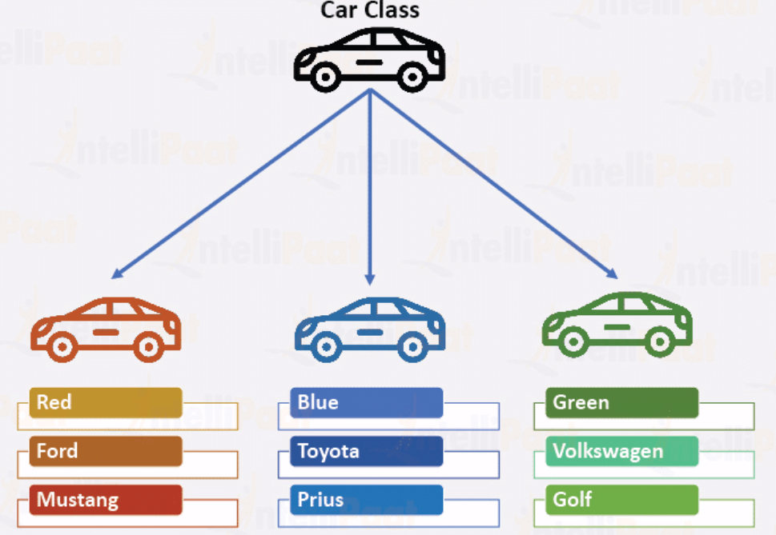

Slide 5
Core properties of object-oriented programming
Abstraction
Inheritance
Encapsulation
Polymorphism

